Slide 1


Is Hadoop a necessity for Data Science?

Slide 2





What will you learn today?
Let us have a quick poll, do you know the following topics?
What is Big Data & Hadoop?
What is a Data Product?
What is Data Science?
Why Hadoop for Data Science?
Is Hadoop a necessity for Data Science?

Slide 3
What is
Big Data & Hadoop?

Slide 4

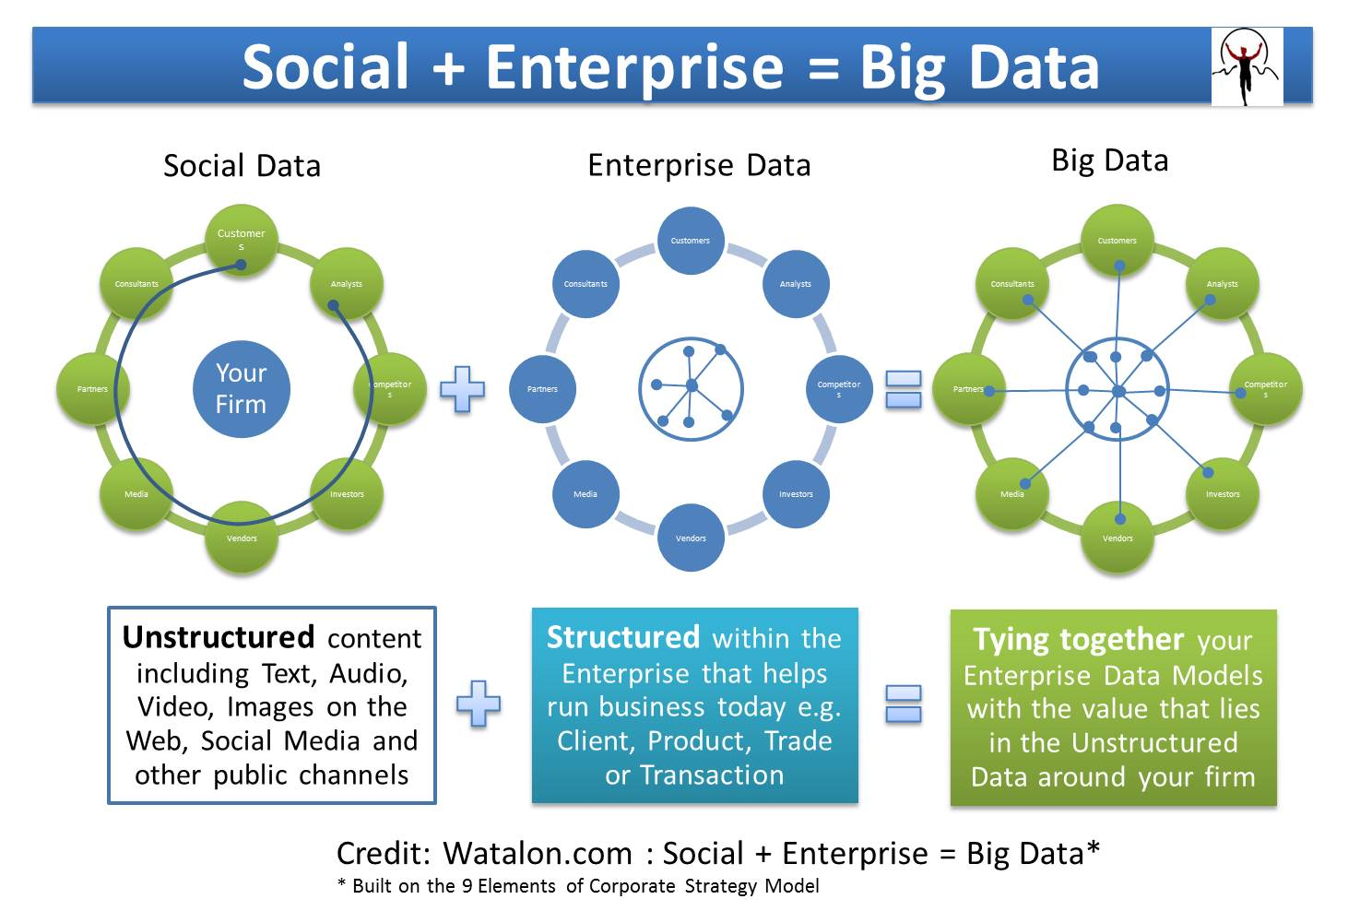
BIG DATA
Big data is a popular term used to describe the exponential growth of data.
Big Data can be either Structured data or Unstructured data or a combination of both.

Slide 5
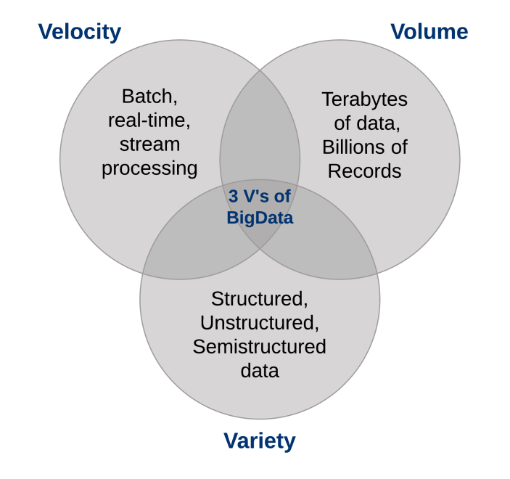
BIG DATA
3 V’s(Volume, Variety and Velocity) are three defining properties or dimensions of Big Data.

Slide 6

HADOOP
Hadoop is a programming framework that supports the processing of large data sets in a distributed computing environment.
Hadoop was the first and still the best tool to handle Big Data

Slide 7
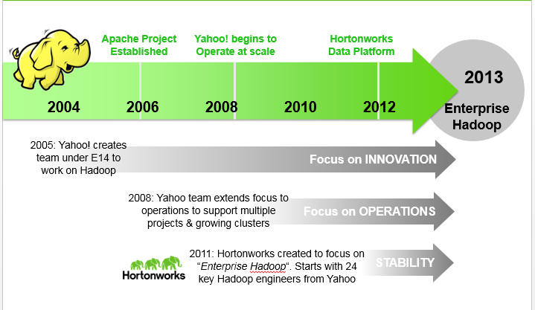
A BRIEF HISTORY OF HADOOP

Slide 8
HADOOP:- HDFS & MAP-REDUCE
Most efficient for Large-Scale Storage & Processing
HDFS: Distributed file system & a Self-Healing Data store
MAP-REDUCE: Distributed computation framework that handles the complexities of distributed programming

Slide 9
KEY TO HADOOP’S POWER
Computation co-located with data
Data and computation system co-designed and co-developed to work together
Process data in parallel across thousands of “commodity” hardware nodes
Self-healing; failure handled by software
Designed for one write and multiple reads
There are no random writes
Optimized for minimum seek on hard drives

Slide 10
What is a
Data Product?

Slide 11
Data product?
“A software system whose core functionality depends on the application of statistical analysis and machine learning to data.”

Slide 12
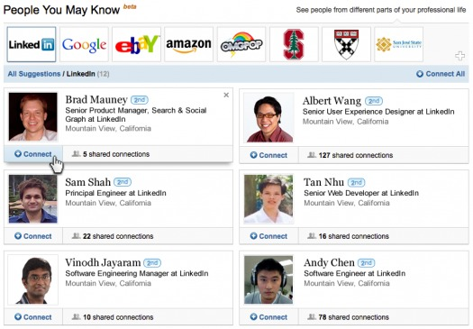
Example #1: People you may know

Slide 13
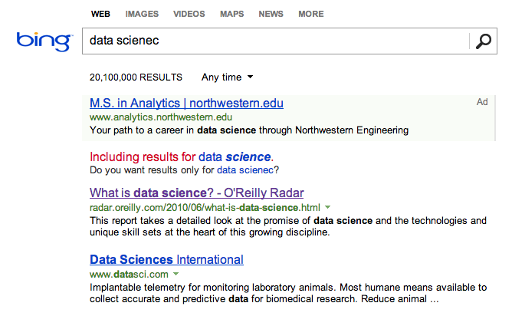
Example #2: Spell Correction

Slide 14
What is
Data Science?

Slide 15
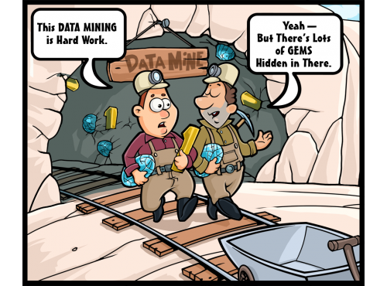
DATA SCIENCE
#1: Extracting deep meaning from data
(data mining; finding “gems” in data)

Slide 16
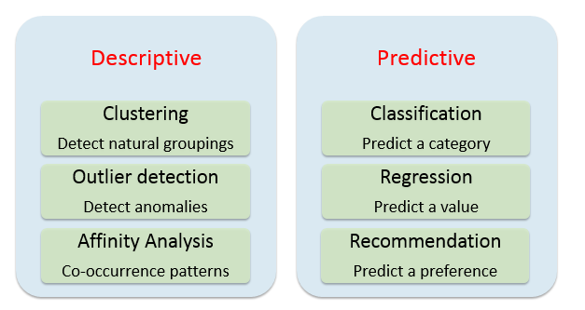
Common Data Science tasks

Slide 17
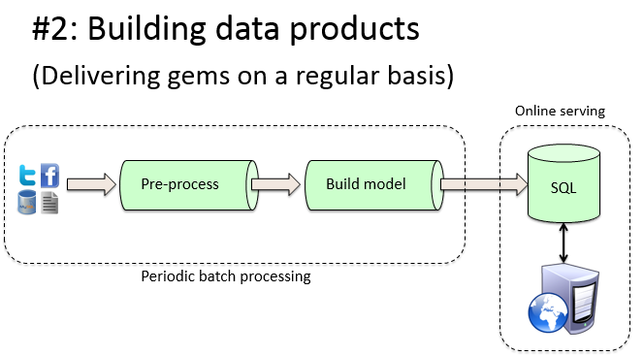
DATA SCIENCE
#2: Building Data Products
(Delivering Gems on a regular basis)

Slide 18
Why Hadoop for Data Science?

Slide 19


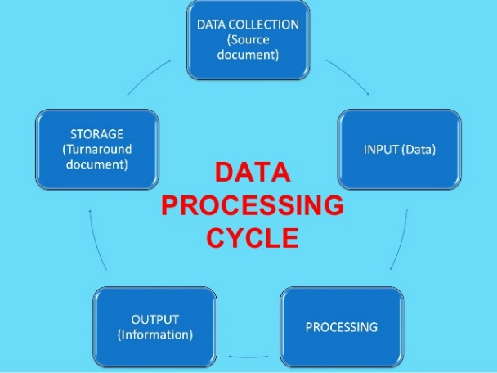
Reason #1: Explore the entire Dataset

Slide 20


Reason #2: Mining of larger Datasets
More Data ---> Better Outcomes

Slide 21
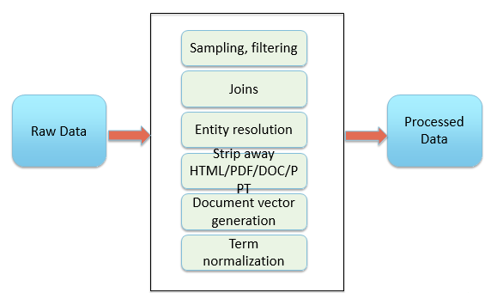
Reason #3: Large-scale Data-Preparation
80% of data science work is data preparation

Slide 22
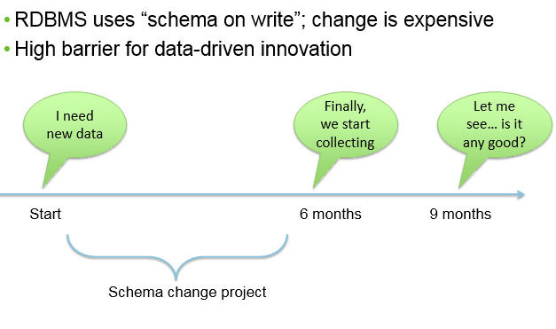
Reason #4: Accelerate data-driven innovation
Speed Barriers of traditional Data Architectures

Slide 23
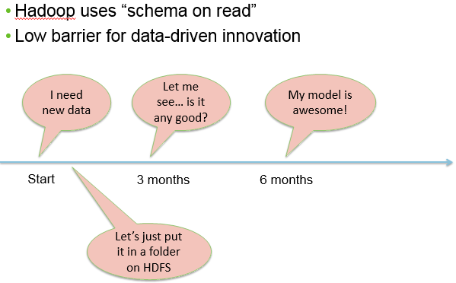
Reason #4: Accelerate Data-driven Innovation
“Schema on read” means faster time-to-innovation

Slide 24
Demo

Slide 25

Survey
Your feedback is vital for us, be it a compliment, a suggestion or a complaint. It helps us to make your experience better! Please spare few minutes to take the survey after the webinar.

Slide 26
Thank You
Questions/Queries/Feedback
Recording and presentation will be made available to you within 24 hours

